Slide 1
FRN Research Methods Sessions
RMS – July 2023
CRFS – Research Methods Support project

Slide 2
Making the most of participatory methods in our research
Interview with Carlos Barahona, Ric Coe and Jane Poole

Slide 3
Session Aims
In this session, we will discuss the following:
The diverse use of participatory methods for research by CRFS projects.
There are a vast number of tools available and our CRFS colleagues use these widely
How can the use of these tools contribute to high-quality research?
How does the use of these tools generate results which go beyond our local context?
Links to the last FRN WG meeting (June 2023) when Jutta Blauert presented on her experiences of conducting Participatory Evaluation with farmers.
Notes:
From start…

Slide 4
Participatory Research
The use of participatory methods is extensive in CRFS. This is vital, given our commitment to inclusion and equity.
Difference between participatory research and participatory monitoring & evaluation:
Participatory Research Aims to generate new knowledge and understanding
vs
Participatory Monitoring & Evaluation Aims to generate information to assess actions towards achieving a specific goal.

Slide 5
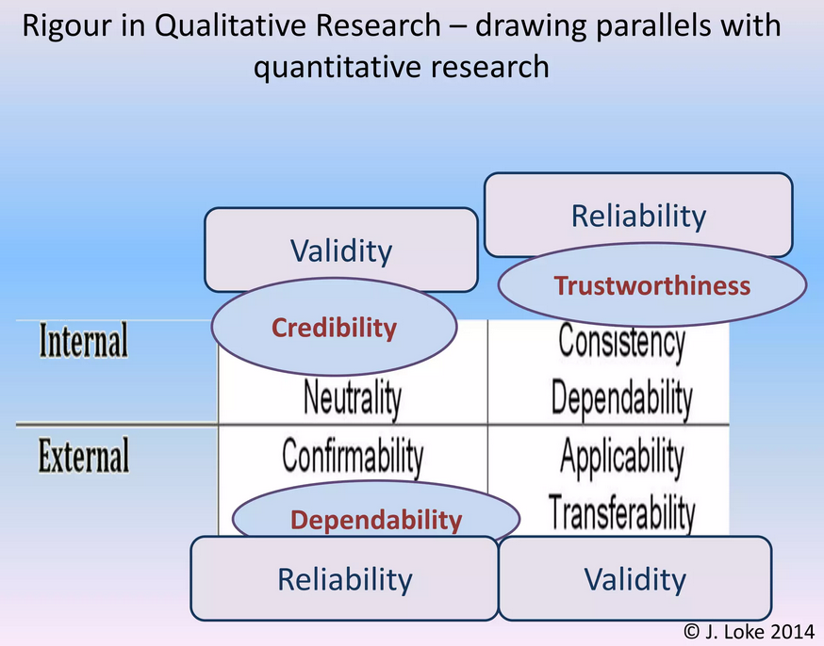
Results must be useful
If results are to be useful then: relevance, credibility and rigour are (still) important when using participatory methods
They may not have absolute definitions.
Engage with partners to construct these definitions.
Dr Jennifer Loke - Lecturer at The University of Hull - Faculty of Health and Social Care
Notes:
Start around 01:38

Slide 6
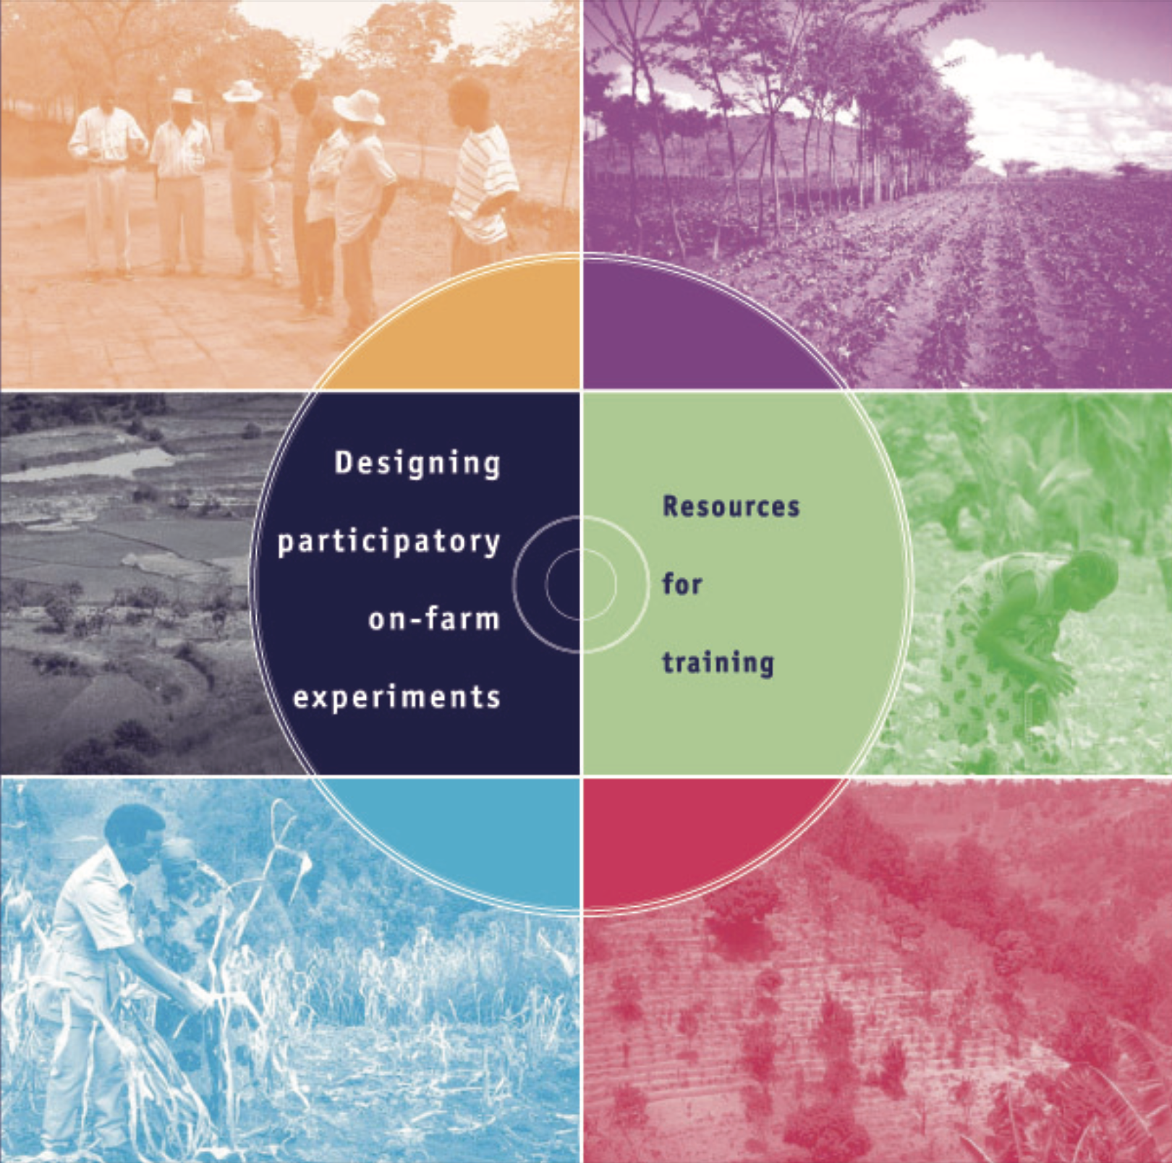
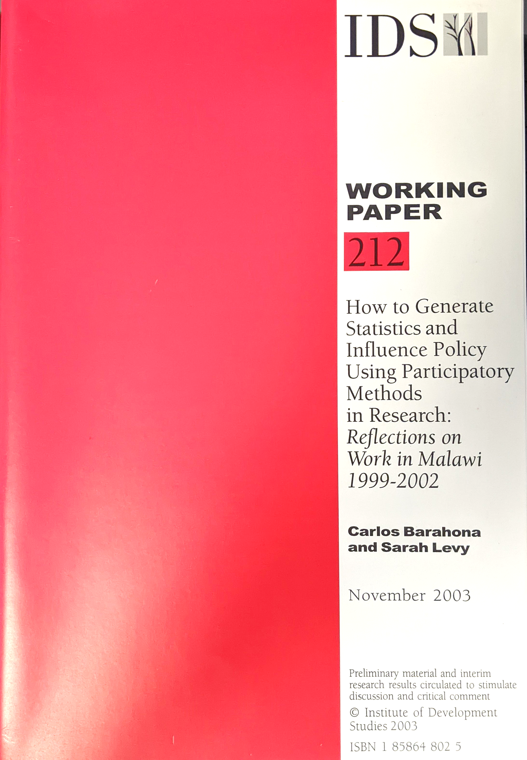
Participatory Research for Agroecology
Why is the discussion about whether and how to use participatory methods still relevant?
Because change (of people and organisations) happens slowly
Our current research agenda and the context in which research is done are very different from 40 years ago.
Participatory Action Research (PAR) is a key part of agroecology.
Carlos and Ric have been writing about participatory methods for 20 years
Notes:
Change around 01:49

Slide 7
Participatory Research for Agroecology
PAR represents a challenge, illustrated by CCRP/CRFS approach of Farmer Research Networks (FRNs)
An FRN involves farmers, researchers and others working together in PAR; solving location specific problems and changing farming systems.
But not all farmers can be in an FRN.
Therefore, participatory research must produce knowledge that both helps participants and is useful beyond the location in which it was generated.
The knowledge we produce about agroecology system change needs to be generalizable. This is our core methods challenge.
Notes:
Change around 02:47

Slide 8
What is good research?
Relevance
Whether it is useful to the context in which the results of the research will be used.
Research could be highly relevant at the local level, but irrelevant at other levels (e.g. global).
We need our research to produce both local and global results.
Credibility
Varies depending on the audience for the research
Individuals may have credibility (experience, reputation) although this can be biased.
The logic that is provided may be credible, researchers often use this justification.
The delivery of the message may also be given credibility.
Rigour
Doing things according to the rules that the community that is interested in the results considers to be the ‘right way’.
Notes:
Change around 04: 25

Slide 9

Are results using participatory methods publishable?
The ‘research establishment’ often claims that participatory research is not publishable.
Publishable - something that the rest of the world will find interesting and relevant; needs to be valid and rigorous.
Within agroecology research our standard approaches remain useful (e.g. Randomised Block Design)
Agroecology requires a systems orientated and integrated approach - so we need MORE than the standard set of tools.
Notes:
Change around 06:50

Slide 10
What is good research?
Principles of good research – remain important and relevant for Participatory Research
How researchers can contribute within the co-creation process.
This may include many different types of research, both participatory and non-participatory (e.g. lab-based research).
Some research can be conducted by researchers alone, some by farmers alone and some jointly.
Replication
Randomisation
Avoiding bias
Precision
Objectivity
Repeatability
Notes:
Change around 08:15

Slide 11
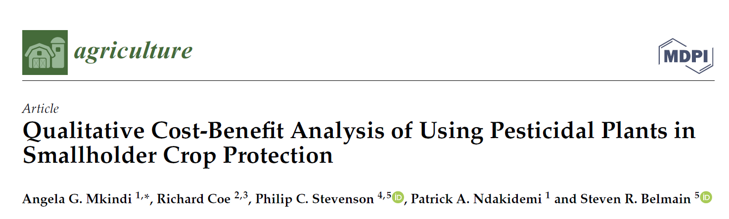
Example: Botanicals Project
Integrated studies on efficacy of pesticides combined with farmers opinions on this (knowledge, benefits, disadvantages etc.)
Participatory activity - groups of farmers talking about the issues
9 communities, same protocol and process
Careful data recording and processing.
Producing succinct messages to look at consistency across communities; drawing general conclusions.
Able to write up and publish
Notes:
Change around 12:30

Slide 12



Adapting participatory methods for research
Standardisation
of what we do, where and how we record.
Structure
of the activities, the way things are done. For example, stratifying by gender, defining the crop area vs. outside.
Coverage
multiple communities and that these capture the diversity of the context (representative and informative).
Notes:
Change around 14:35

Slide 13
Participatory Research is a process
Participatory research is a (longer) process - not about a single research activity.
To generate real knowledge we need to think beyond a single participatory activity and tool (e.g. FGD)
Process where we contribute different elements of the research process and build together the hypothesis and answer these as we learn
CCRP / CRFS has shown the potential to achieve good research results due to our ongoing activities with the same participants.
Notes:
Change around 15:38

Slide 14
Who are the participatory research and the results generated for?
Farmers might be interested in some elements (e.g. disease levels reduced in a crop)
Researchers might be interested in how the farmers respond to this, their attitudes, who is engaged or not engaged?
Within one activity, different groups can be interested in different types of results.
Notes:
Change around 16:50

Slide 15
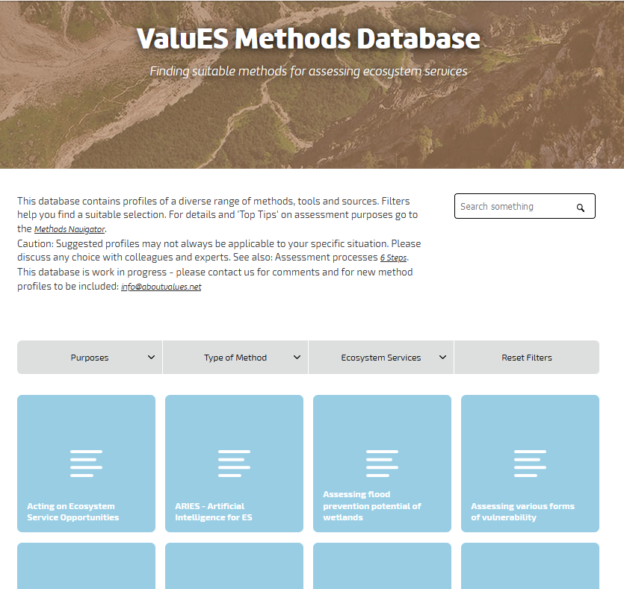
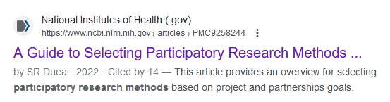
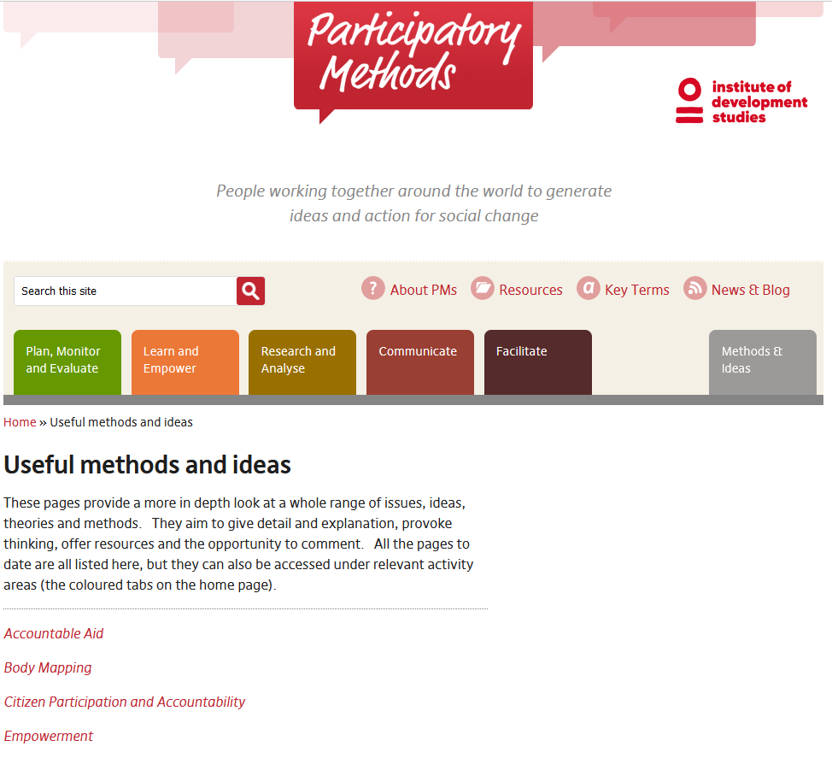
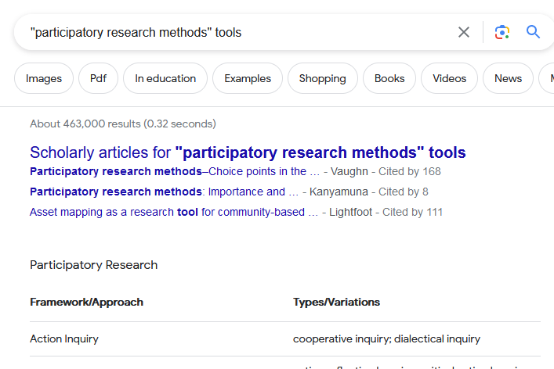
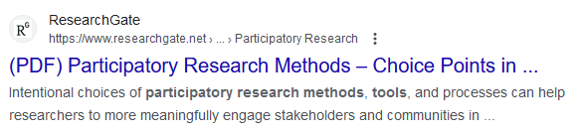
Participatory research methods tools
There are thousands of participatory research methods tools that have been described, promoted and used.
Which ones are useful for our research?
Notes:
Change to this around 17:45 (and the next slide maybe 20 seconds later because the discussion goes between the two)

Slide 16
Which participatory tool for our research?
The question is not ‘which’ tool but:
How to engage with partners using a collaborative, co-created approach to answer different questions and share learning.
Why and how we use it.
Is it relevant to the objective?
Are we using it mindfully?
Is it used with rigour? – are we able to repeat the process and describe to others what we have done?

Slide 17
Helpful References
Barahona C and S Levy (2003) “How to Generate Statistics and Influence Policy Using Participatory Methods in Research; Reflections on Work in Malawi, 1999-2002”, working Paper no.212, Brighton, Institute of Development Studies, 8. https://www.ids.ac.uk/files/dmfile/Wp212.pdf
Designing participatory on-farm experiments: Resources for Trainers. January 2003. Publisher: World Agroforestry Centre https://www.researchgate.net/publication/258926044_Designing_participatory_on-farm_experiments_Resources_for_Trainers
Green LW, Glasgow RE. Evaluating the relevance, generalization, and applicability of research: issues in external validation and translation methodology. Eval Health Prof. 2006 Mar;29(1):126-53. Doi: 10.1177/0163278705284445. PMID: 16510882. https://pubmed.ncbi.nlm.nih.gov/16510882/
[1] Leung L. Validity, reliability, and generalizability in qualitative research. J Family Med Prim Care. 2015;4(3):324-327. doi:10.4103/2249-4863.161306. https://www.ncbi.nlm.nih.gov/pmc/articles/PMC4535087/
Denise F. Polit, Cheryl Tatano Beck (2010). Generalization in quantitative and qualitative research: Myths and strategies. International Journal of Nursing Studies 47 (2010) 1451–1458

Slide 18
Topics for Group Work
You have heard a discussion among colleagues who all come from a quantitative background. What important elements were not mentioned that you think are important to ‘participatory approaches in research’?
What are your experiences and challenges with using participatory activities at local level when we want to reach global knowledge?
What experience do you have or challenges you have experienced publishing results from participatory activities? What can we do to remove these challenges?

Slide 19
From the series: FRN Research Methods Sessions 2023
Created and presented by RMS
CRFS – Research Methods Support project
July 2023

