Slide 1
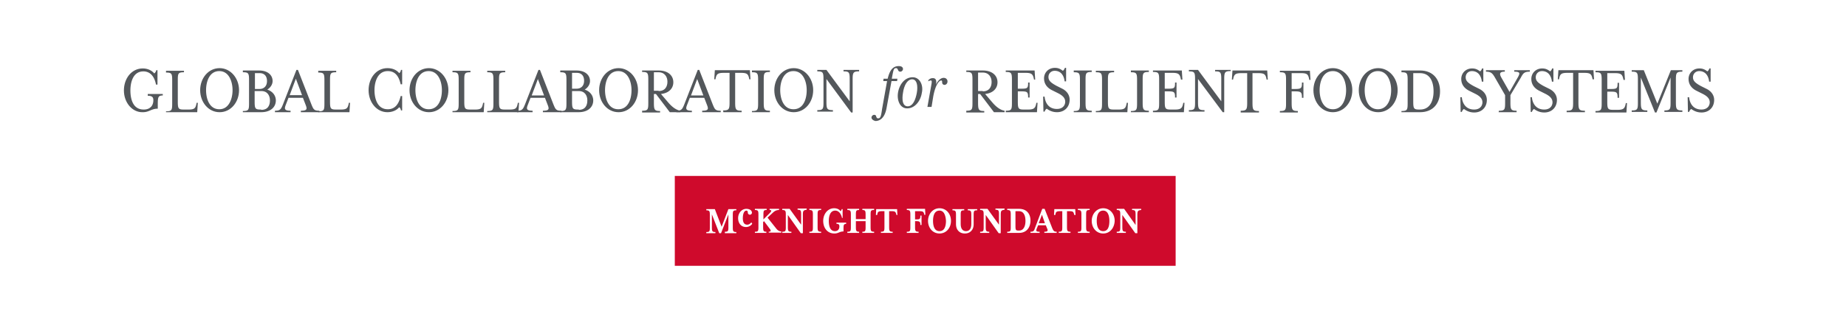

Collaboration in Research
Research Methods Support seminar, 22 June 2023
Lucie Hazelgrove-Planel
lucie@idems.international
stats4sd.org/resources
Notes:
2 mins
I introduce myself and reminder of RMS

Slide 2
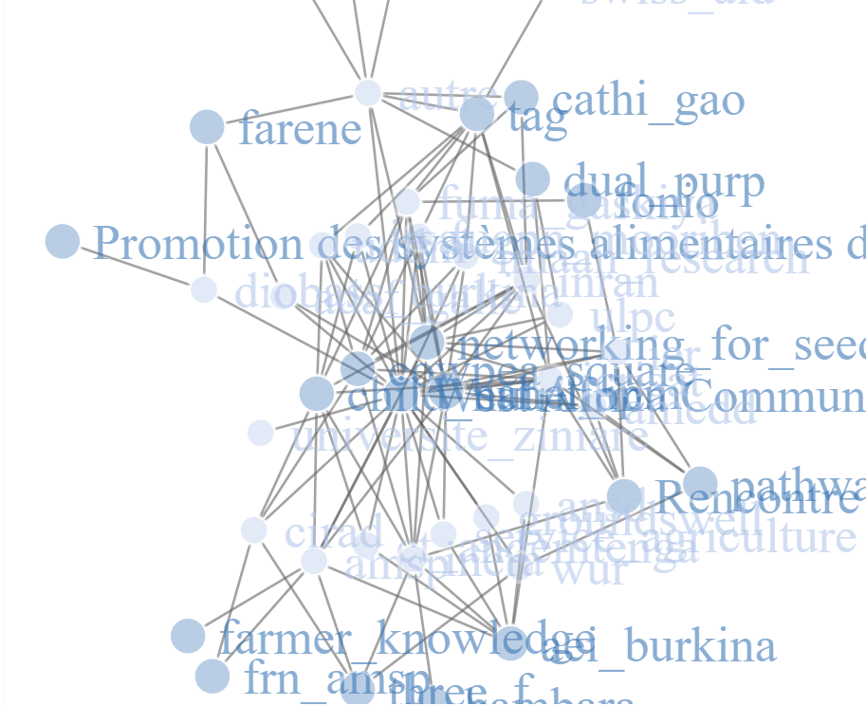
Why collaboration?
From the Collaborative Crop Research Program (CCRP) to the Global Collaboration for Resilient Food Systems (CRFS):
→ Collaborations are central to our research
How can we work together to transform food systems?
What resources, perspectives, expertise do we need?
What can we share?
Notes:
Good collaborations aren’t equal: they’re mutually beneficial
Everyone has been doing this for a long time. It’s not something new, but it’s hard.
From ‘synergies’ to ‘strategic collaborations’

Slide 3
CRFS (the new CCRP) principles
C – Principles of Collaboration | Operational Principles
INCLUSION Convene multiple and diverse stakeholders to inform deliberations at all levels and locations of decision-making GENUINE COLLABORATION Ensure authentic collaborative engagement | Reciprocity: Build trust based on shared interests & honest interactions Mutuality: Negotiate win-win agreements Realistic engagement: Start where people are Nudge: Generate movement
R- Principles of Research | Operational Principles
FARMER-RESEARCHER CO-CREATION Engage farmers as partners to ensure relevance, use of research processes & results RESEARCH FOR AEI IMPACT Design and implement research to achieve impact (generating options by context for improving crop systems) | Enhance quality through capacity building Integrate local & global research Link social & technical inquiry Integrate farmer knowledge into the research Incentivize, support & reinforce farmer participation to ensure responsiveness to farmers' needs, knowledge, problems, concerns & constraints Make the research process empowering, build social, technical, and methodological capital through the farmer-researcher co-creation process Phased and emergent design & implementation
CCRP-principles-2.pdf

Slide 4
FRN principles
1. Diverse farmers participate in the whole research process
1.1 Farmers co-create the research agenda.
1.2 Farmers are engaged throughout the research process.
3. Networks are collaborative and facilitate learning and knowledge sharing
3.1 Networks support learning and knowledge sharing among all members.
3.2 Networks are made up of connections among differently positioned actors and encourage the flow of learning throughout the network.
GCRFS Working Groups - FRN Resources (google.com)

Slide 5
An example from l’AMSP:
Association Minim Song Panga (AMSP) is a farmer organisation in Burkina Faso that has been involved in the CRFS since 2006.
From working with farmers, l’AMSP now brings together leaders of farmers’ organisations and has about 5,000 members in five communes.
AMSP is a key partner in many projects and since 2019 has been lead organisation on the project FRN learnings at AMSP to learn how we can develop strong FRNs and improve how we work together.
The following audio has been generated from the translation of a conversation in French between Lucie and Roger Kaboré, Director of lAMSP
Notes:
Highlight the different potential benefits of those collaborations - and to whom?
How does the collaboration you do with farmers differ from the other types of research collaborations?
How do you present these principles to others and introduce them to the projects?
How does your role within the collaborations change/has it? How to scale - go from an individual to an organisation as a bridge?

Slide 6
L’AMSP’s experiences
1) Understand the farmers and the researchers:
Their strengths and weaknesses
Their motivations
What structures they work within
2) Bring people together:
Go at their pace
Identify the right people for the job
Share learnings from both sides
3) Scaling up:
Then: one central mediator
Now: one mediator to bring the researchers together
Farmer facilitators/mediators to bring farmer groups together
Several facilitators/mediators within l’AMSP: AMSP can be considered a mediating organisation in and of itself
Notes:
Highlight the different potential benefits of those collaborations - and to whom?
How does the collaboration you do with farmers differ from the other types of research collaborations?
How do you present these principles to others and introduce them to the projects?
How does your role within the collaborations change/has it? How to scale - go from an individual to an organisation as a bridge?

Slide 7
L’AMSP’s experiences
For example,
Though they’re involved in Research and Development as an organisation, they initially did a lot of research.
On crop varieties;
Then on agriculture more broadly.
After farmers highlighted their interest in the development side too, this is now also a priority for them.
How can they scale up and support more farmers?
How can they encourage support from national bodies?
A call to arms: within the CRFS, in our latest CoP meeting, someone identified two needs:
For projects to share their results
To share their skills and knowledge.
Notes:
Highlight the different potential benefits of those collaborations - and to whom?
How does the collaboration you do with farmers differ from the other types of research collaborations?
How do you present these principles to others and introduce them to the projects?
How does your role within the collaborations change/has it? How to scale - go from an individual to an organisation as a bridge?

Slide 8
Anthropology and collaboration
Or: Can collaborations be equal?
Or: Should collaborations be equal?
Cultural relativism
A method for understanding the other, guided by:
others don’t necessarily think like you
there is always a logical reason behind what people do or think
don’t judge: difference doesn’t mean better or worse
Notes:
What is anthropology
What colour is the rectangle? What do you associate with this colour?

Slide 9

A methodology - problem solving
1. Things aren’t what they seem:
Question everything
Take nothing for granted
Notes:
Do people mean what they say? Do people do what they say? Do people know what they do and why? What is not being said and why? Who is not saying it, and why not?

Slide 10
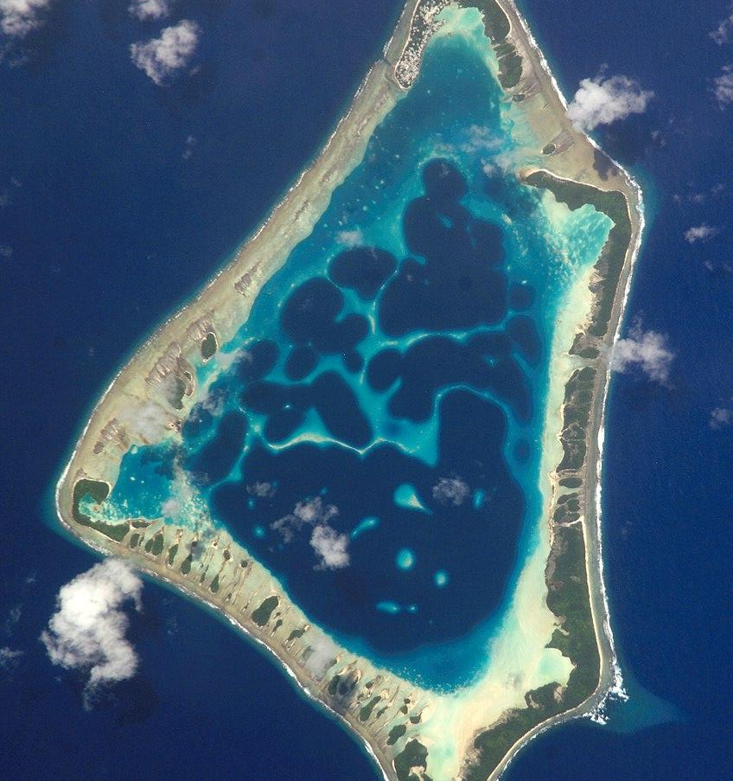
A methodology - problem solving
2. Systems thinking: everything is connected
Nothing is isolated
Consider everything/everyone
This is not an island.
Notes:
Do people mean what they say? Do people do what they say? Do people know what they do and why? What is not being said and why? Who is not saying it, and why not?

Slide 11
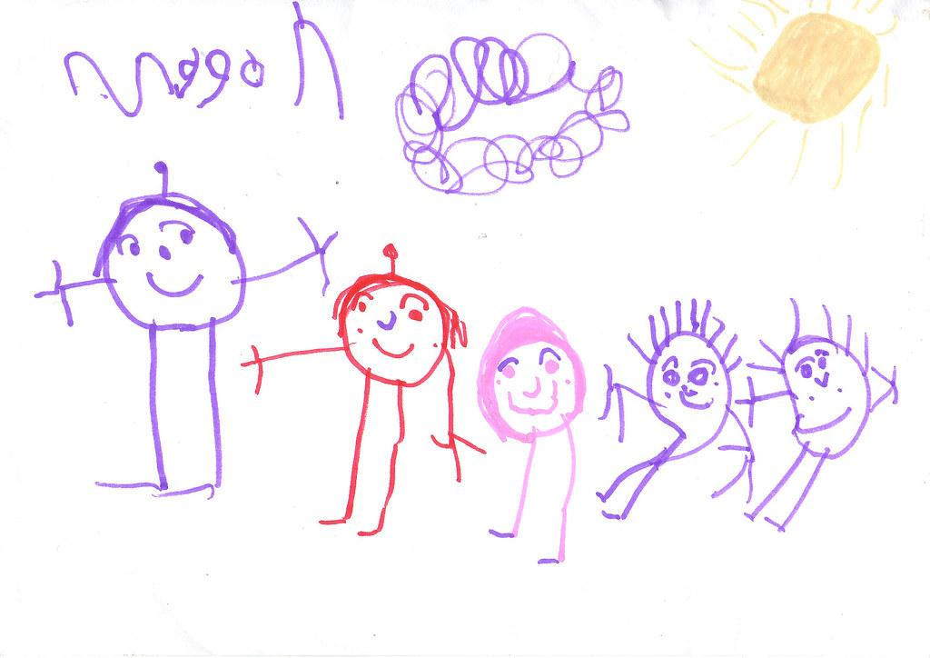
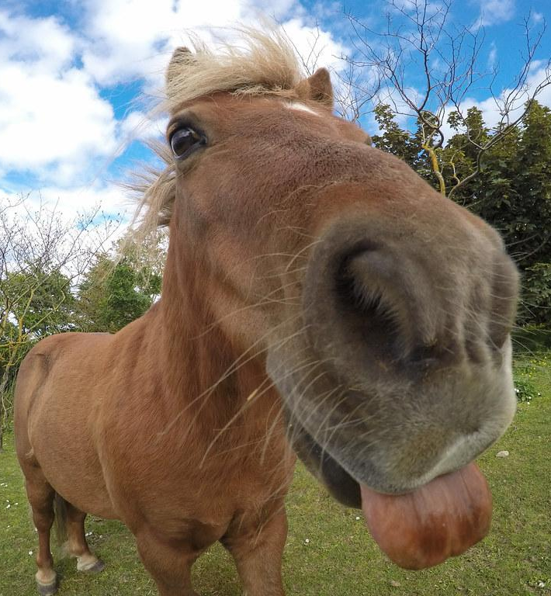
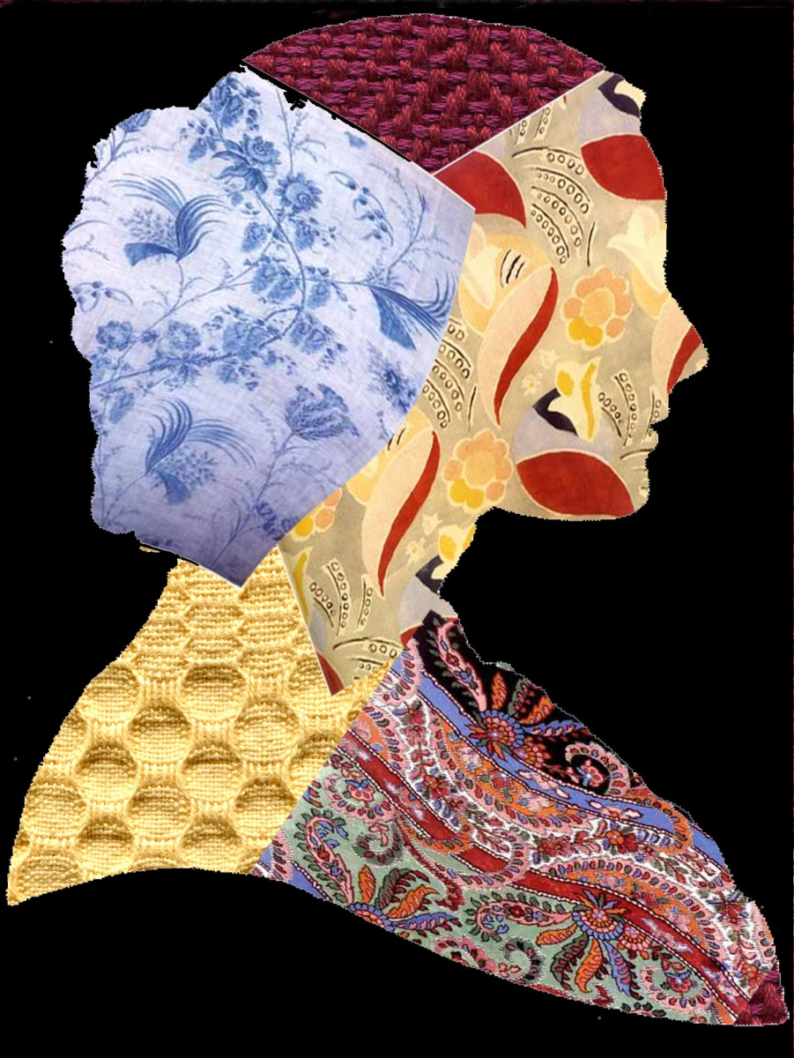
A methodology - problem solving
3. What do people value (in life)?
Notes:
Do people mean what they say? Do people do what they say? Do people know what they do and why? What is not being said and why? Who is not saying it, and why not?

Slide 12
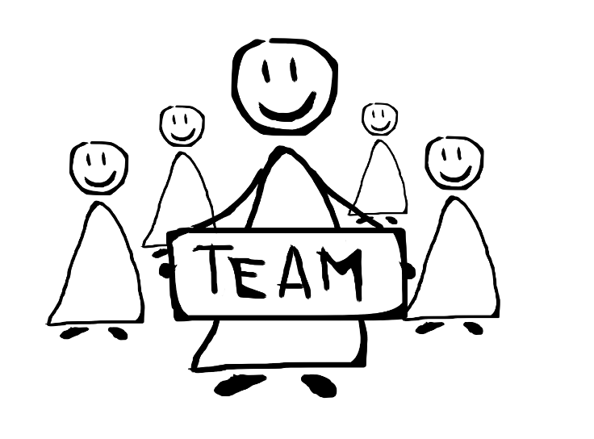
In/equalities in collaborations (1)
Between teams:
Who defines: the parameters; what counts as data; what counts as knowledge?
Who has the knowledge? Which knowledge?
Whose collaboration is it, and for what?

Slide 13

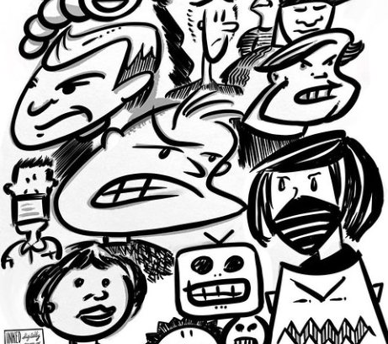
In/equalities in collaborations (2)
There are different types of organisations and structures.
Some organisations or communities are not cohesive wholes.
→ How do you bring together, and not (re)create divisions?
→ How do we transform, rather than replicate, existing power structures?
Notes:
Identify the structure/identity of the organisation
What is a team? Break it down to a collection of individuals with different experiences and perspectives. Break it down further to as individuals, humans are messy.
FRN vs institutional (governments etc)
See FRN session from the festival 2 years ago for a good discussion of this through a gender lens Gender and inclusion in FRNs - YouTube

Slide 14
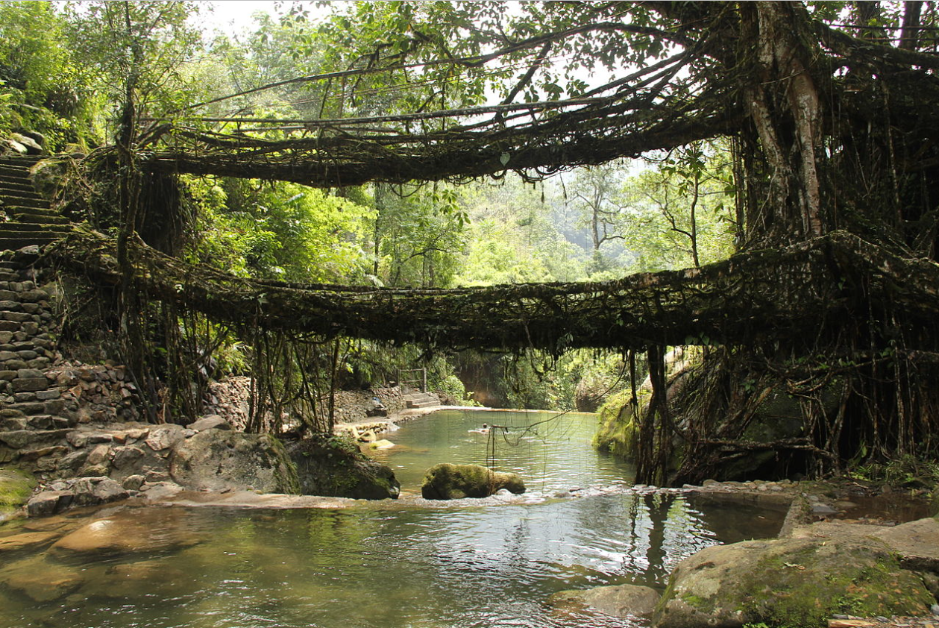
Building (and maintaining) bridges
Someone needs to understand both sides:
what are the aims?
what are the available materials?
what tools or other technical requirements are there?
They can then translate between the two sides (cultural relativism), creating a bridge.
Meghalaya state, India
Notes:
What can we do about this?
How do we collaborate to create change?
When should we work with like-minded groups, and when should we work with those more different to us?
How you work together - or the difficulties of working together - provides rich material for publications and communications.

Slide 15
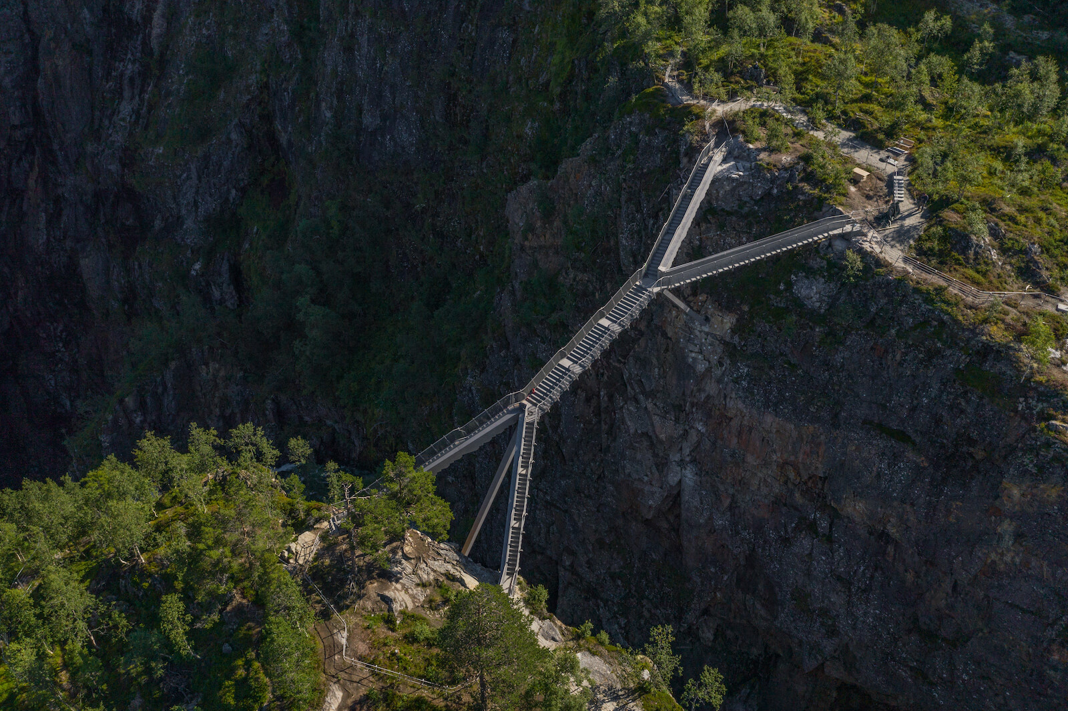
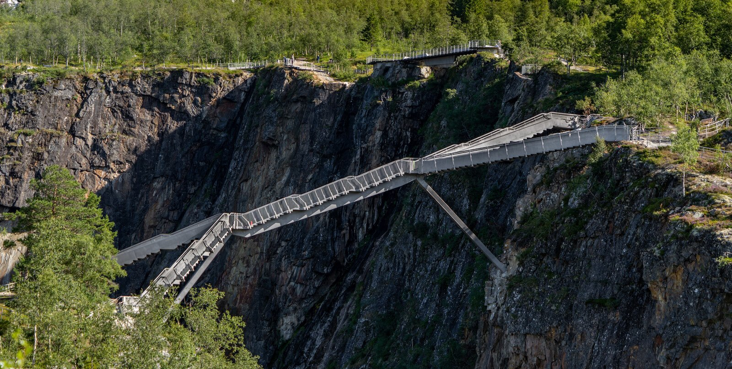
Your experiences
Carl-Viggo Hølmebakk designed bridge in Norway
What challenges and successes in collaborations have you experienced and would like to share?
Bridges don’t need to join two equal sides, but they do need to find a balance.
Notes:
Consider the Operational Principles: Reciprocity; Mutuality; Realistic engagement; Nudge.
Discussion group lead to go back to the CCRP Principles slide to encourage reflection on the operational principles

